Slide 1

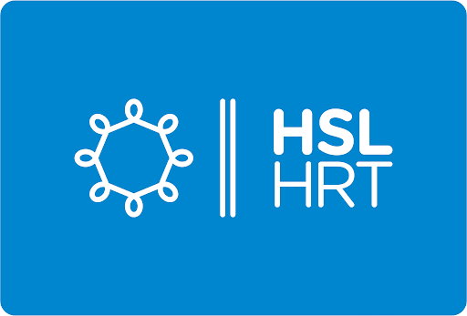






BIP 2024 - Reindeer code NFC
New HSL features
M’FINI Malik, RECOLIN Manon, KOCOGLU Yagmur, BURNOD Clara, ORBLIN Morgane and HALADEJ Ondrej
  Our mission is to harness the power of technology to solve complex problems of city accessibility and empower businesses to thrive in the digital age.

Slide 2


SUMMARY
I) WHO ARE WE ?
II) WHAT'S OUR IDEA ?
III) WHAT IS THE PRODUCT ?
IV) BUSINESS MODEL
V) MARKET
VI) VISION
VII) FOR THE FUTURE STUDIES

Slide 3
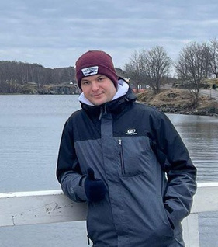
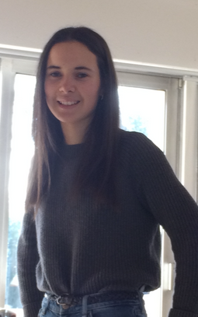



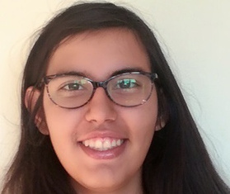
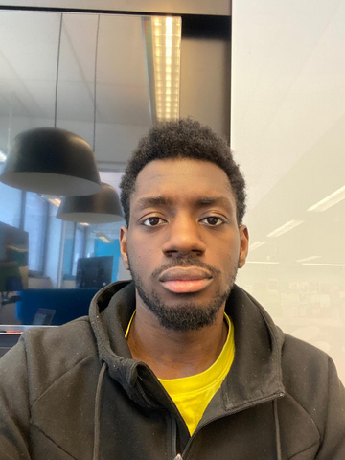


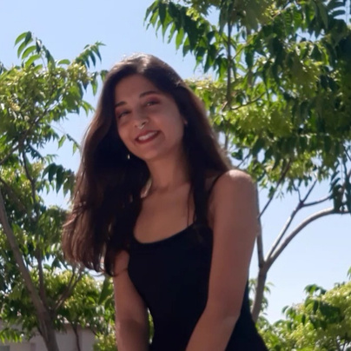
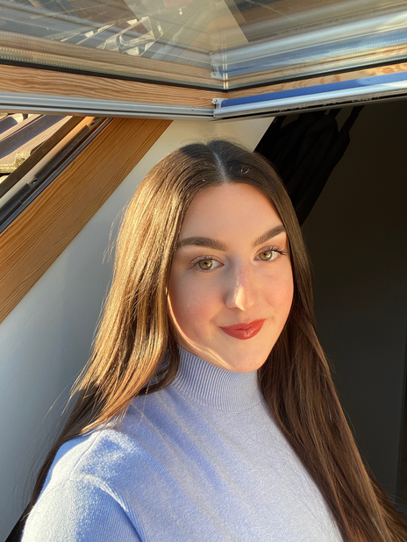
I) WHO ARE WE ?
HALADEJ Ondrej
(Tcheque Student)
BURNOD Clara
(MITIC)
Reinder Code Company is a tight-knit team of six passionate individuals committed to revolutionizing software development.
ORBLIN Morgane
(MITIC)
The aim of this research is to study and solve the problems of accessibility in the transformation of JATKASAARI, focusing on improving inclusiveness and taking into account the diverse needs of residents and visitors.
M’FINI Malik
(MITIC)
KOCOGLU Yagmur
(MIPI)
RECOLIN Manon
(MIPI)

Slide 4
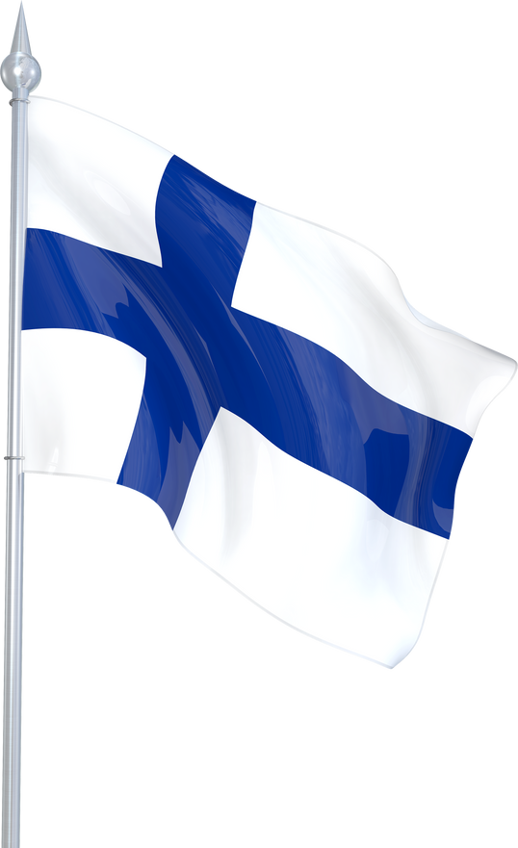
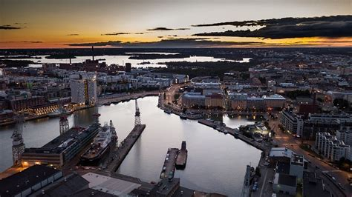

II) WHAT’S OUR IDEA ?
a) Context
When we talked to people in Jatkasaari, we found out they're pretty happy with how transportation works here.
But they mentioned something important : They want more details about accessibility !
For example, they wondered if the roads are suitable for wheelchairs or strollers.
That got us thinking...

Slide 5

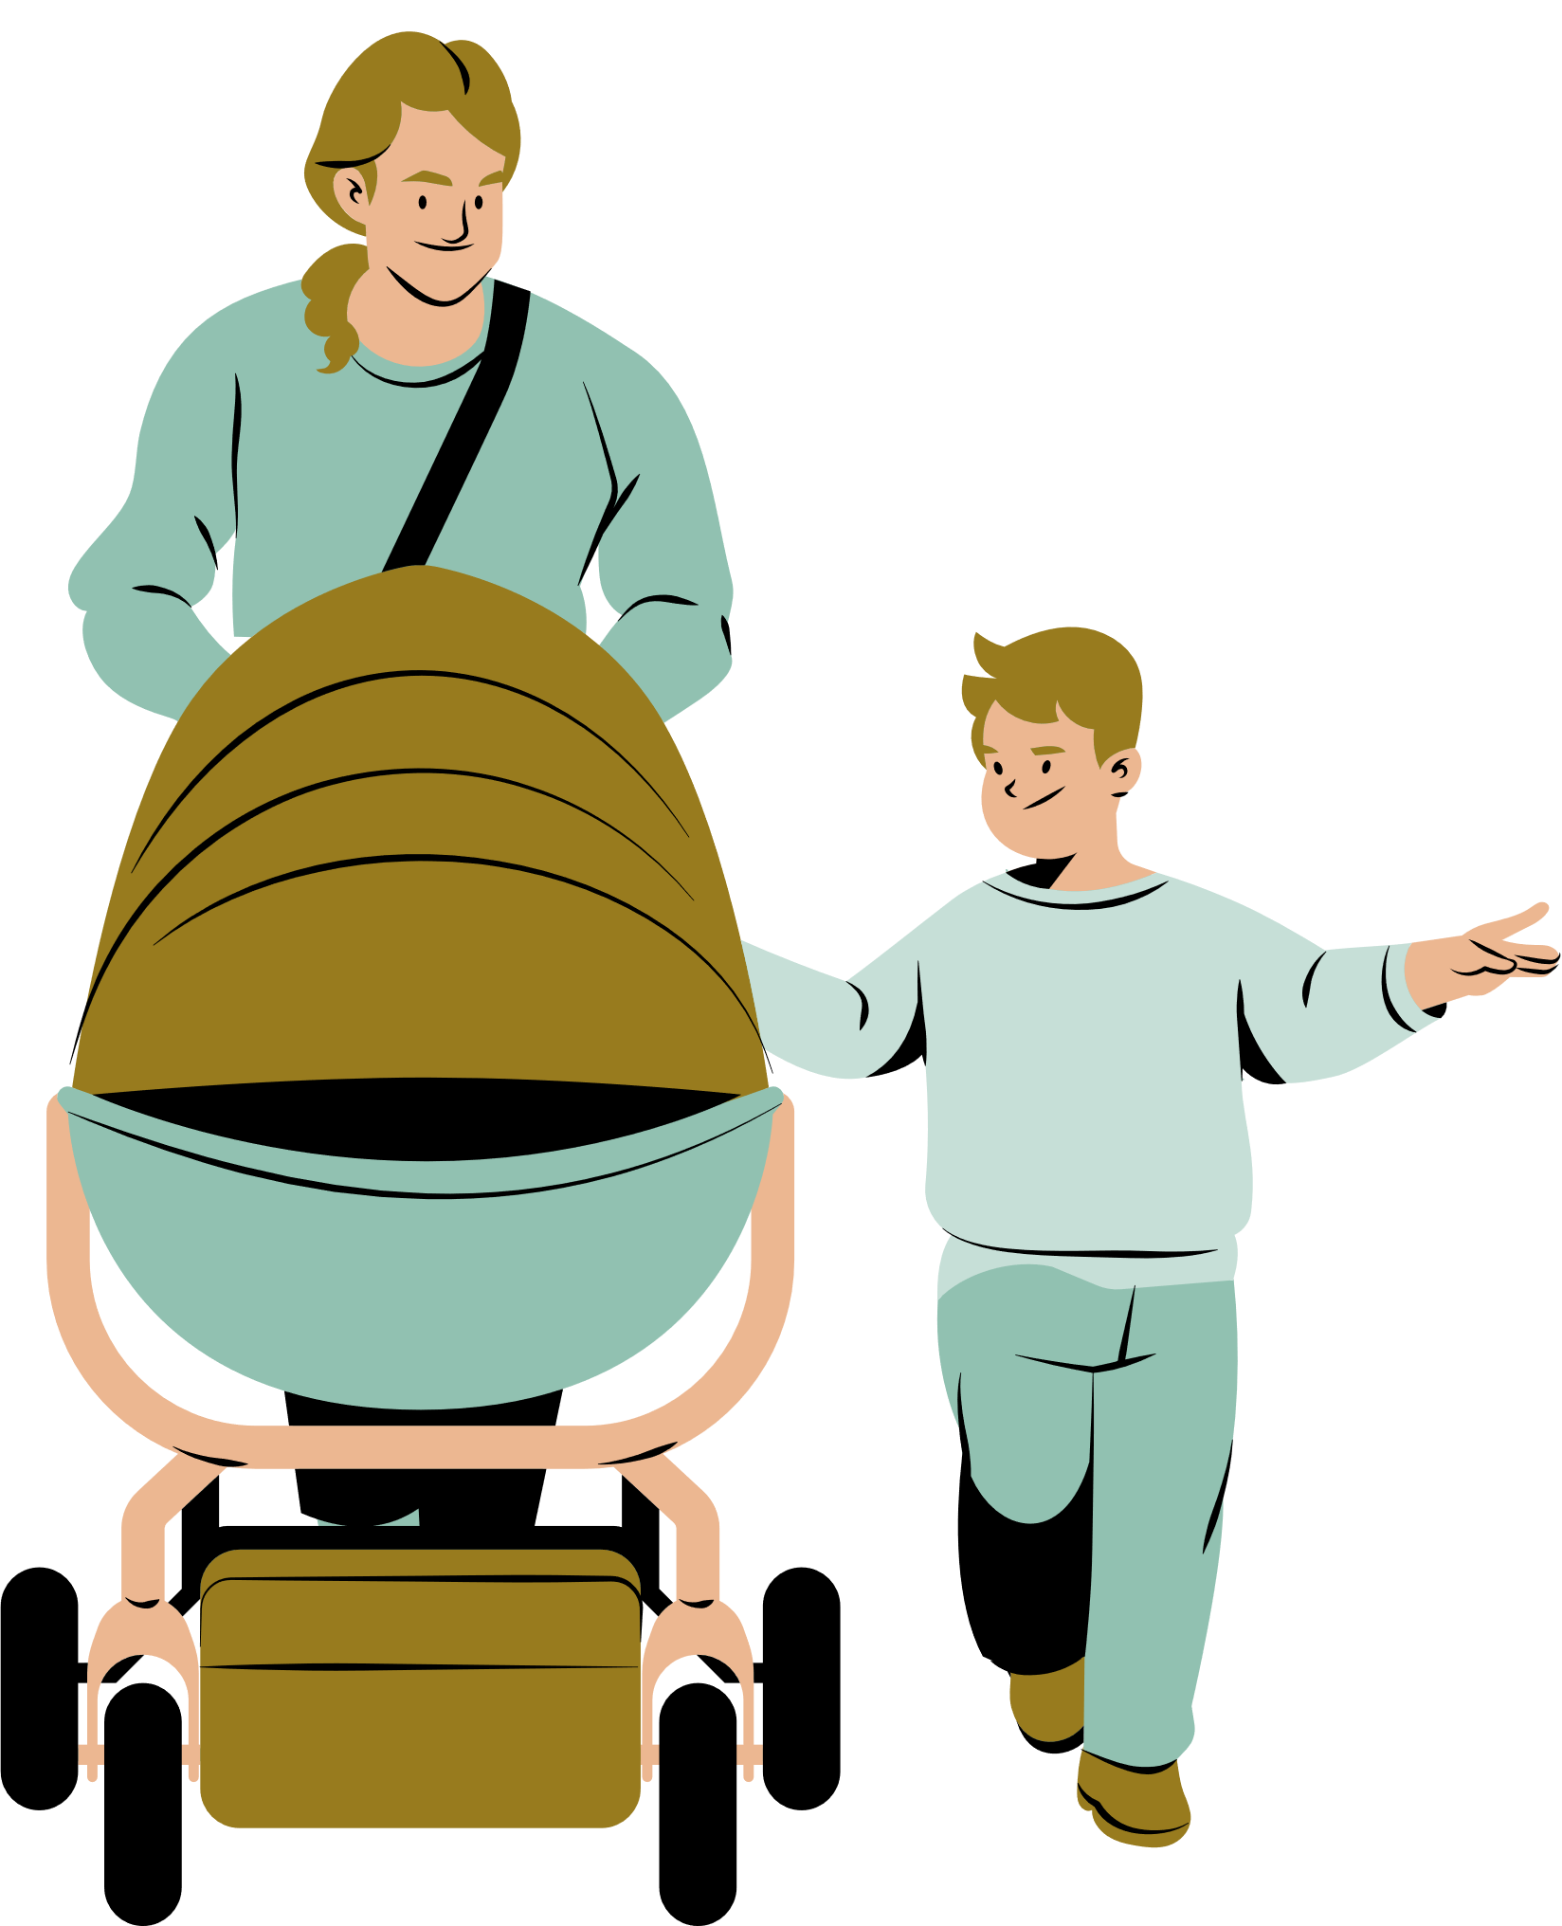
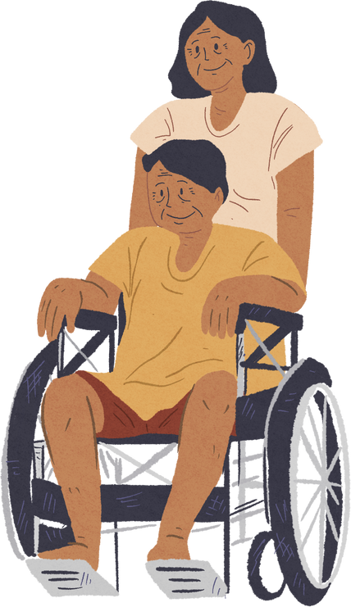
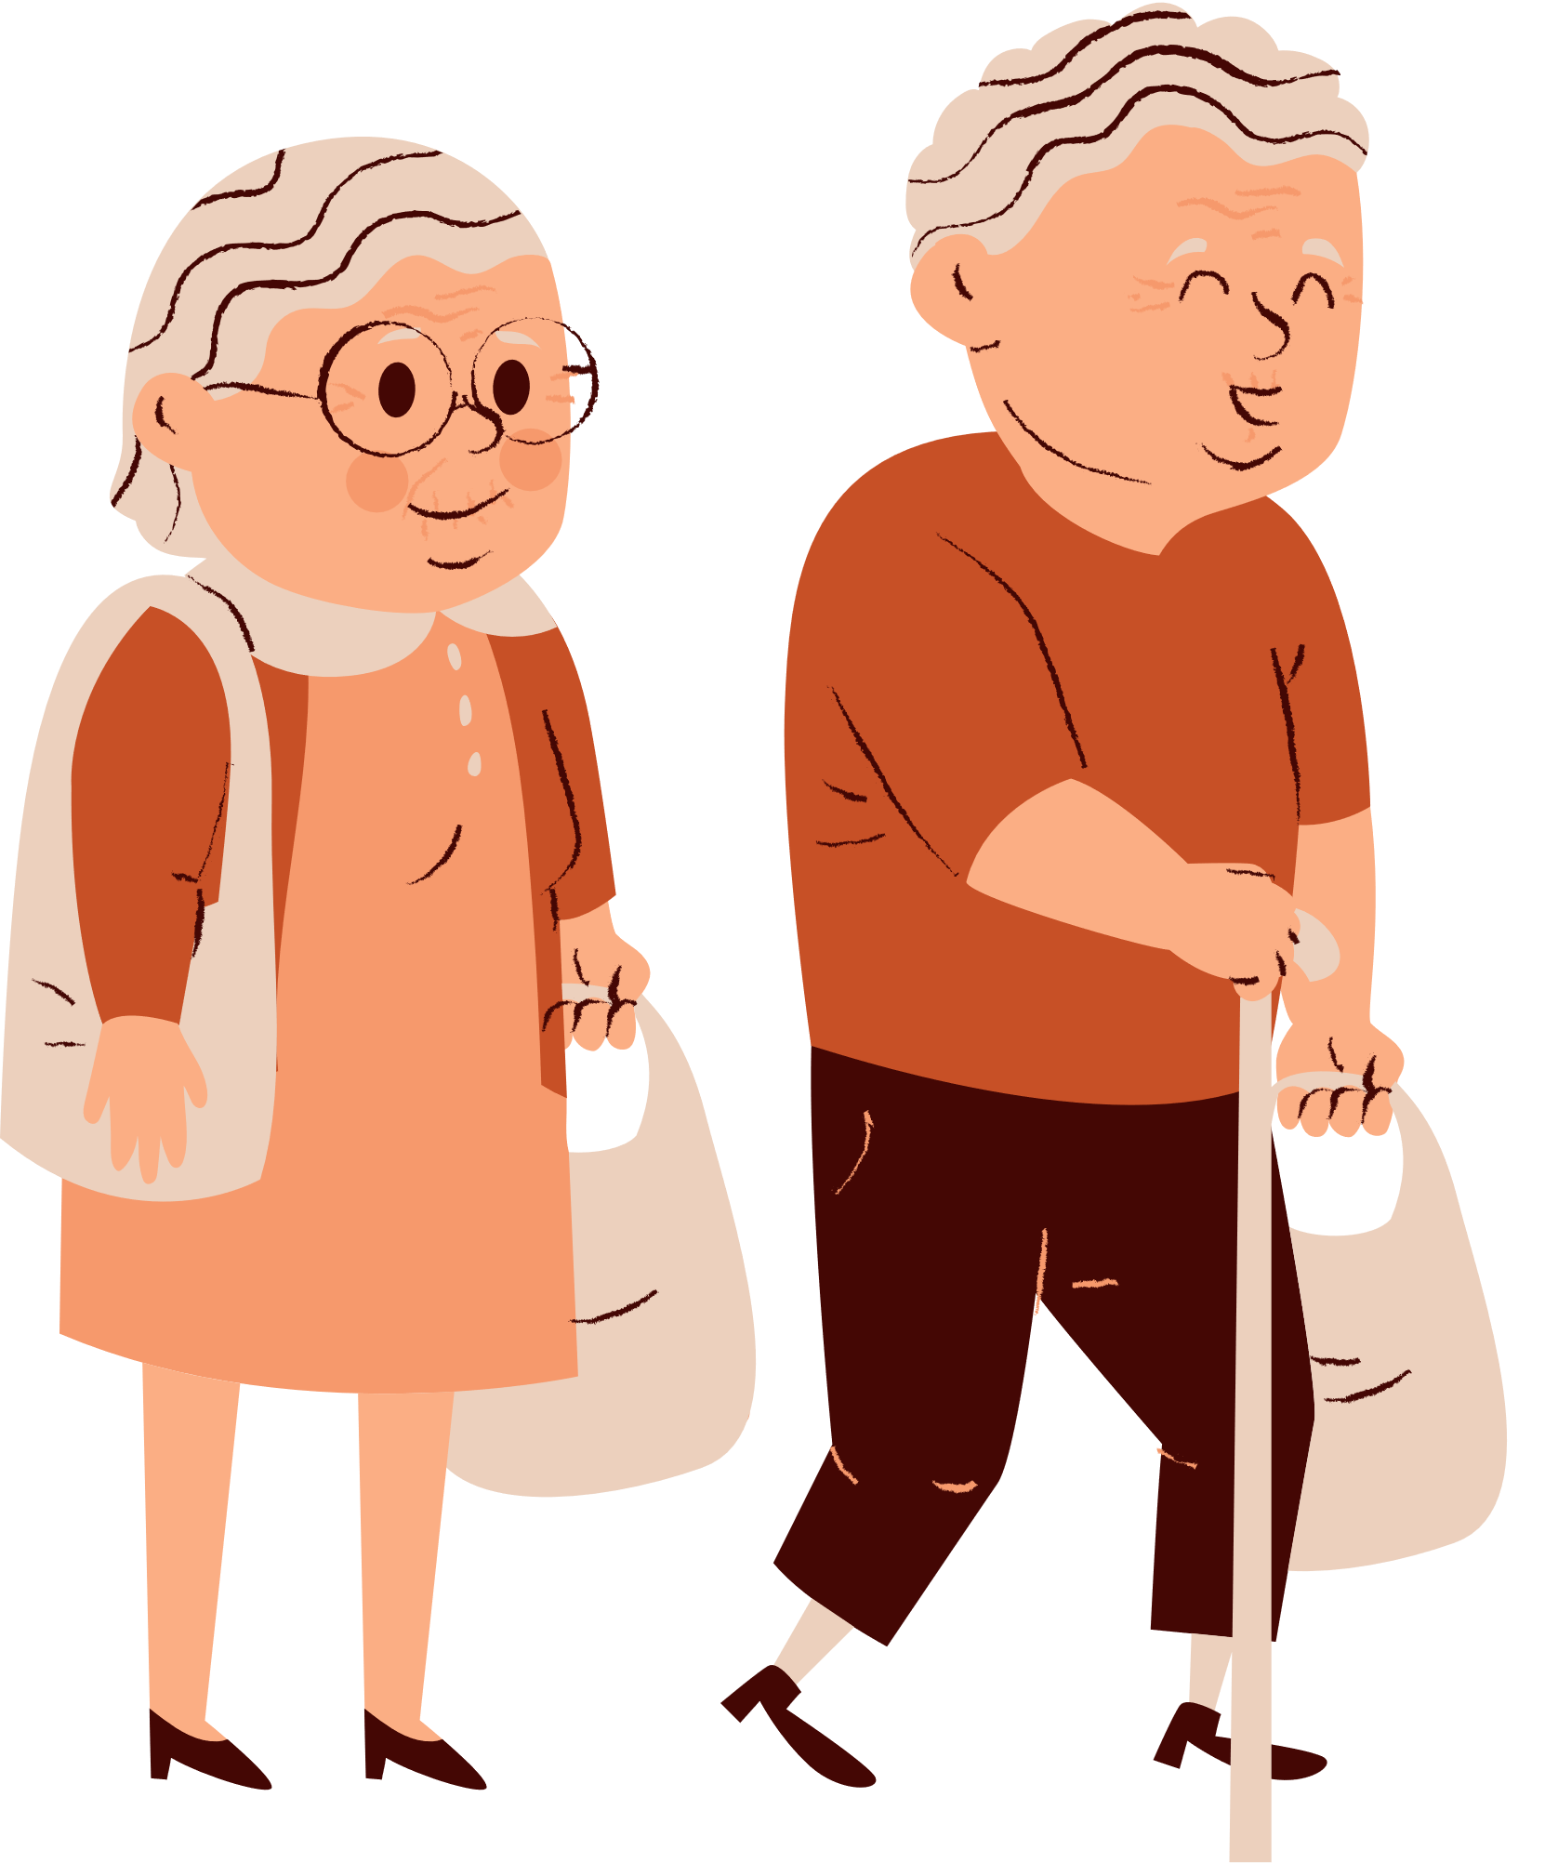
II) WHAT’S OUR IDEA ?
Our idea is to enhance city accessibility and facilitate digital empowerment through innovative software solutions.
Targets :
Name : Jari Järvinen
Age : 45
Name : Tiina Lehtonen
Age : 30
Name : Leena Virtanen
Age : 73

Slide 6

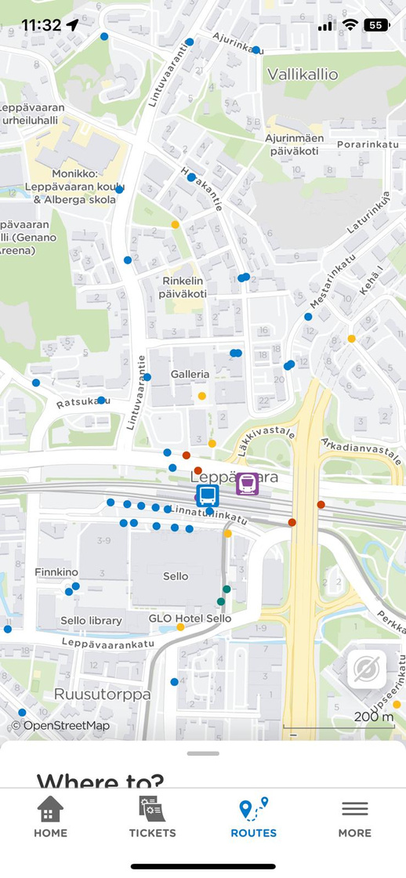
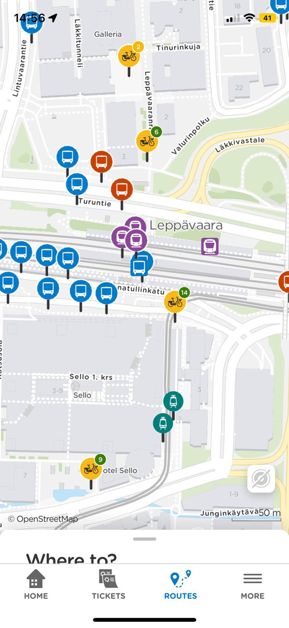
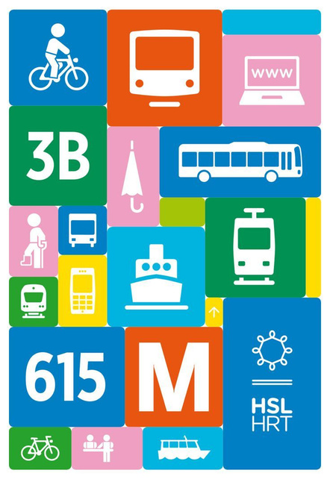

III) WHATS IS THE PRODUCT ?
OPTION 1
New design

Slide 7
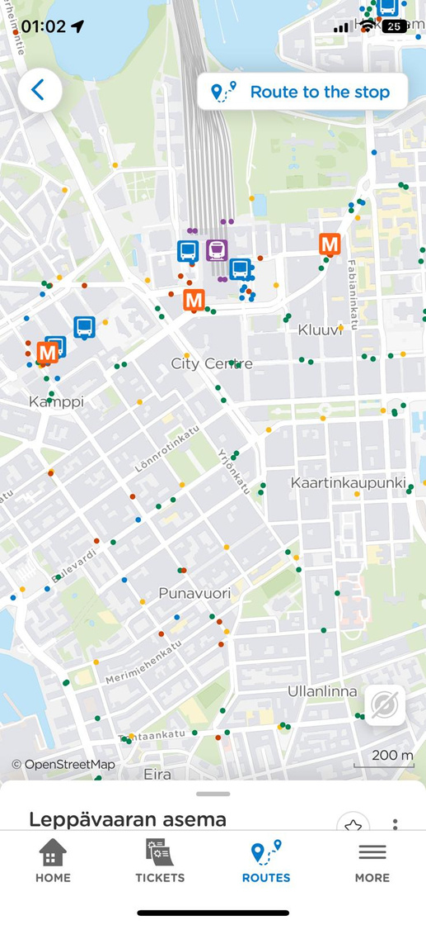


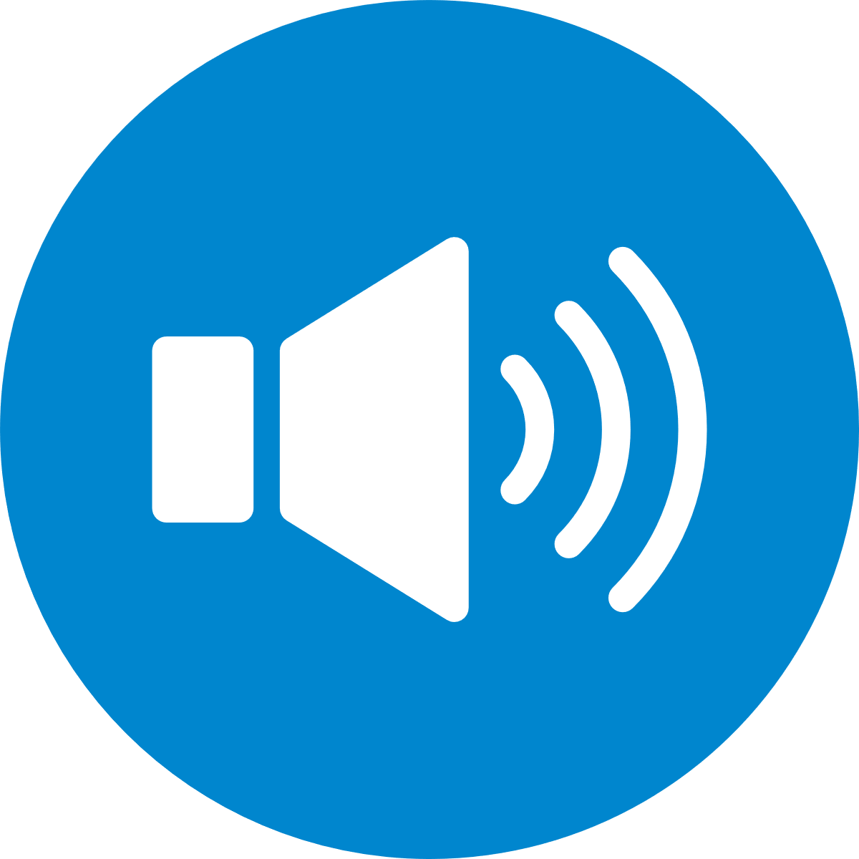
III) WHATS IS THE PRODUCT ?
OPTION 2
The HSL app's chatbot assists you in navigating the transport network, providing instant answers to your questions about routes, schedules, and service disruptions.
The app should support voice commands to allow users to interact without touching the screen.

Slide 8
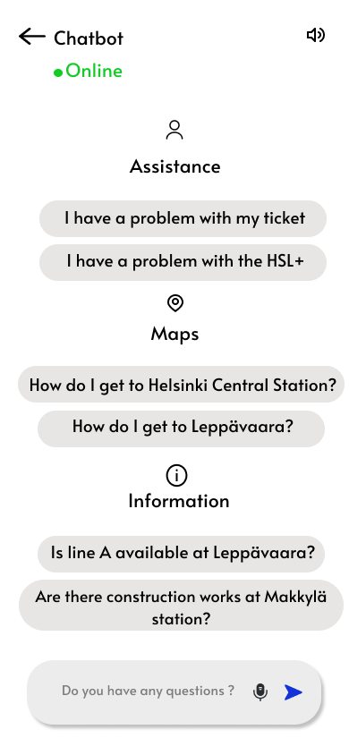
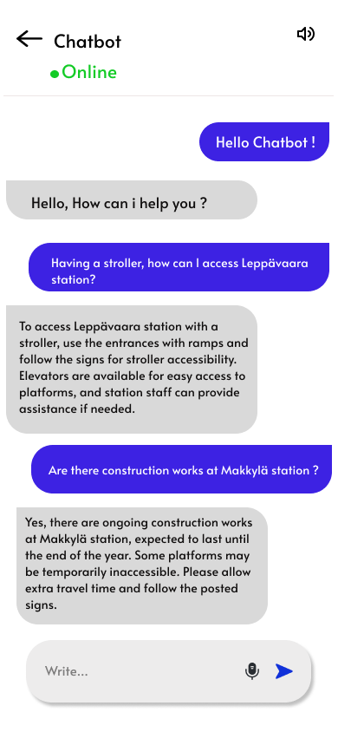
III) WHATS IS THE PRODUCT ?
OPTION 3

Slide 9







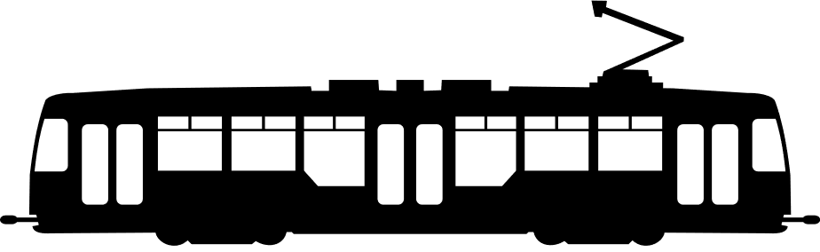
IV. BUSINESS MODEL
Value propositions :
Improved accessibility
Real-time information
Community collaboration
Commitment to sustainability
Client-Centricity

Slide 10


IV. BUSINESS MODEL
Key partners :
Disabled people's associations
  invalidiliitto
Public transport agencies
  HSL
Municipal authorities
Research and development organisations

Slide 11


IV. BUSINESS MODEL
To reinforce the feasibility of our project, we carried out a SWOT analysis :
Strengths :
  Innovative Features
  Client-Centric Approach
  Technical Expertise
  Collaboration
Weaknesses :
  Implementation Challenges
  User Adaptation
Opportunities :
  Market Expansion
  Partnership Opportunities
  Competitive Advantage
Threats :
  Competitive Pressure
  Regulatory Compliance
  Technological Limitations

Slide 12

IV. BUSINESS MODEL
Key resources :
Technology and infrastructure
Technical support
  Accessibility filters
  Voice assistance
  Accessible terminals
  Inclusive signage
  Beacon technology
  24/7 technical support
Software development team
  Python
  SQL
Strategic partnerships
Data and content
  HSL
  invalidiliitto
  Accessibility features at stops
  Develop algorithms

Slide 13
IV. BUSINESS MODEL
Cost Structure :
Category | Cost
AI Tab Development | €50,000
Training & Data
Staff Training | €5,000
Data Acquisition | €10,000
Infrastructure & Maintenance
Upgrade & Maintenance | €15,000
Technical Support
Staff Support & Tools | €10,000
Contingency Reserve | €10,000
Total | €105 000

Slide 14
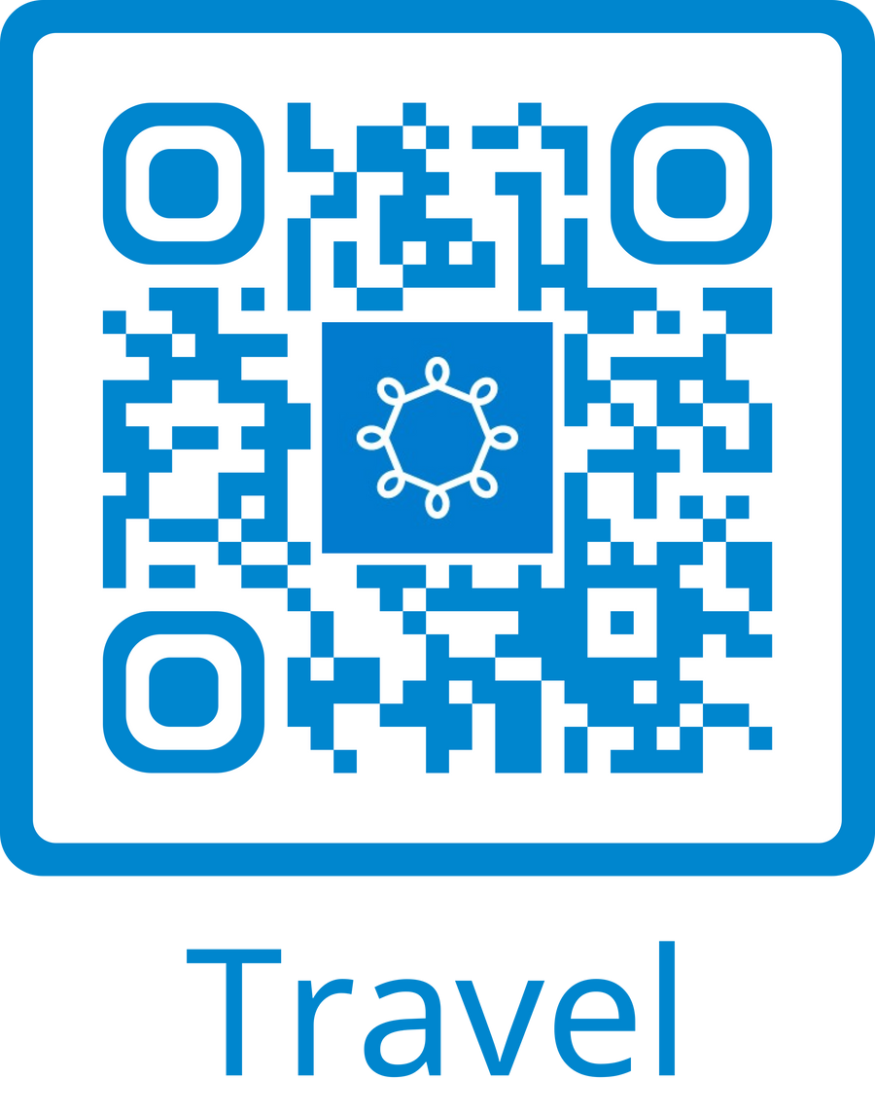

V. MARKET
Our target market includes individuals with disabilities, caregivers, and the general public in Helsinki's public transport system, with a potential reach of 600,000 daily passengers, presenting a substantial market opportunity.
  Ads on Traffic Lights: QR code stickers used for advertisement.
  Station Ads: QR codes placed in and around transportation stations.
  Onboard Ads: Advertising on TV screens inside buses.

Slide 15
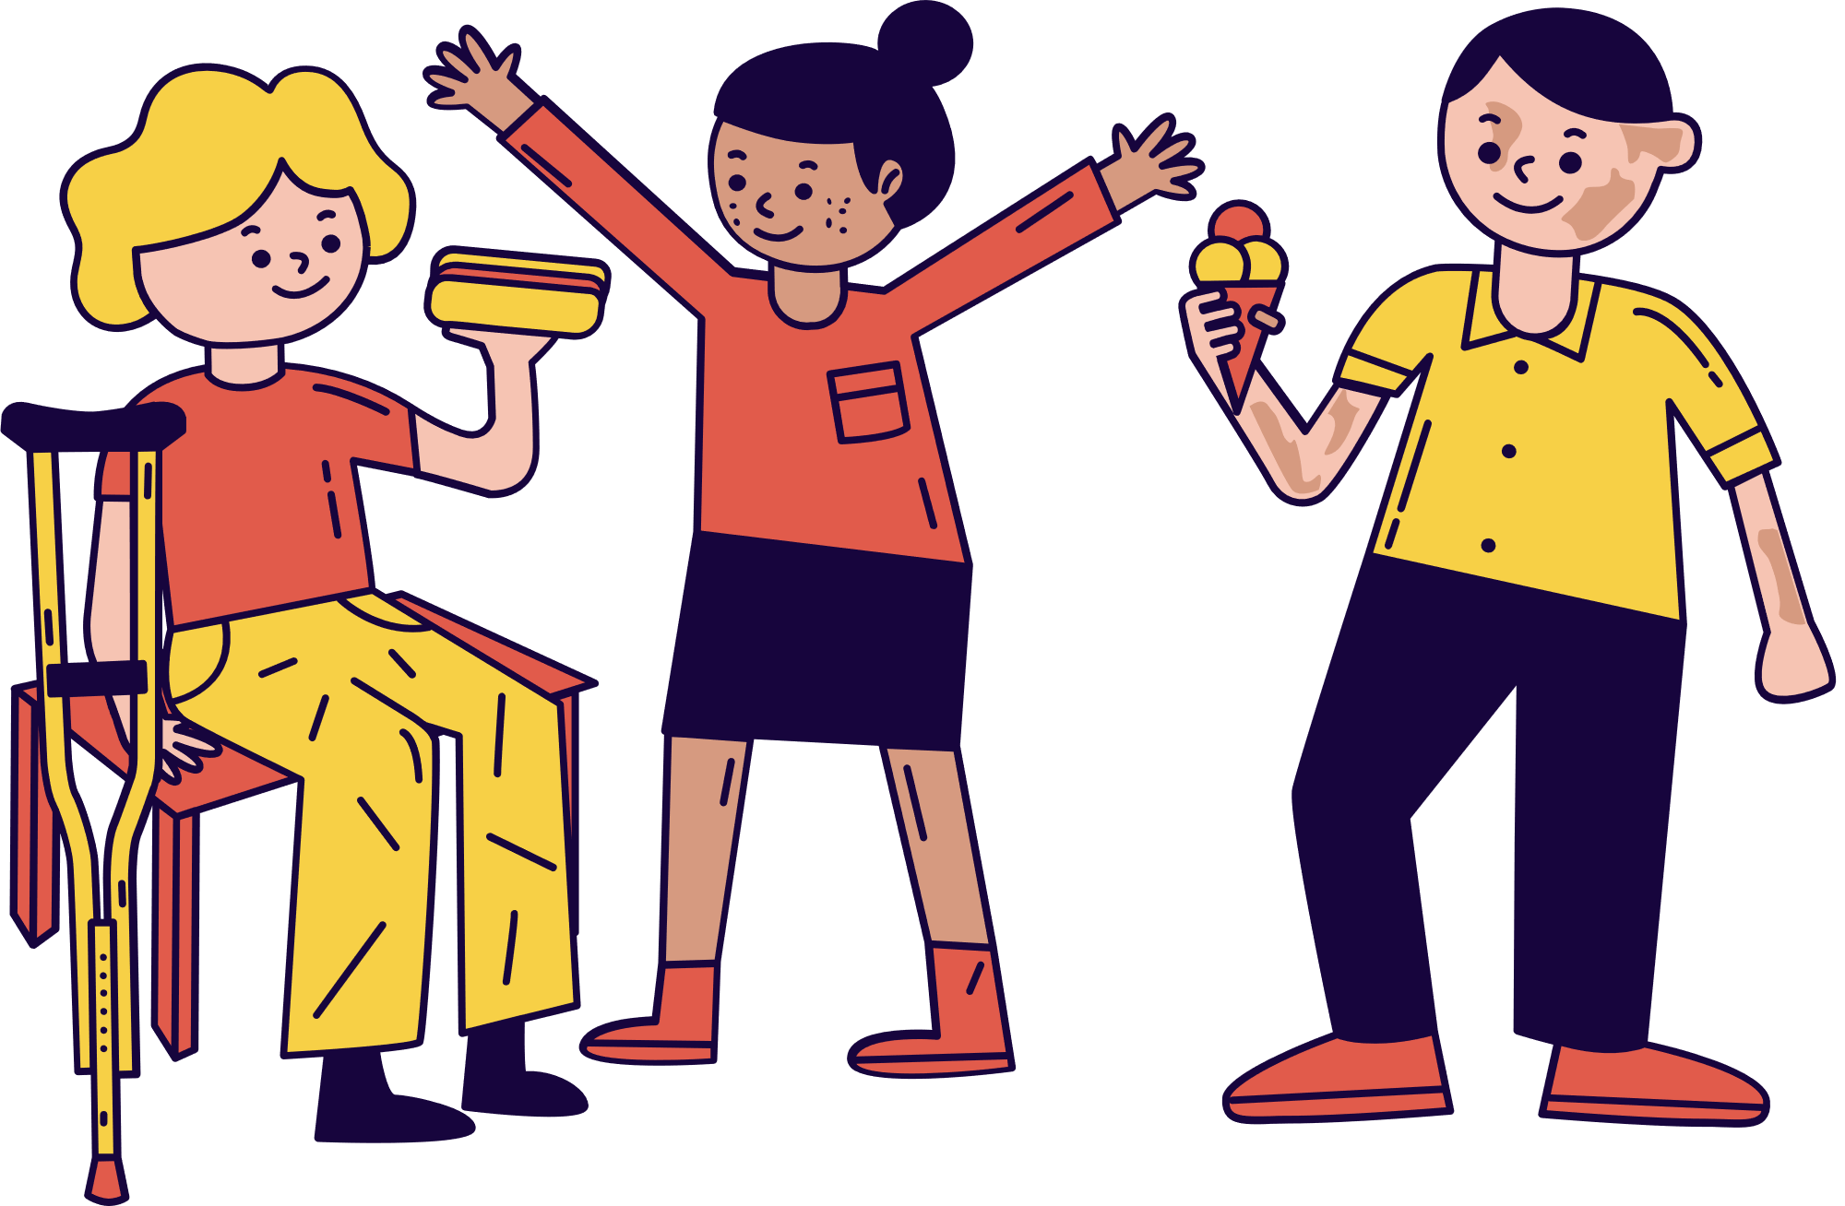
VI) VISION
ENSURE AN INCLUSIVE AND ACCESSIBLE ENVIRONMENT, WITH A FOCUS ON ENHANCING PUBLIC TRANSPORTATION ACCESSIBILITY.

Slide 16
VII) FOR THE FUTURE STUDIES
  Traffic Light Notification System: Implementation of AirTag technology to alert nearby users of traffic lights.
  Voice Command Support: Integration of voice commands allows users to interact hands-free, improving accessibility and convenience.

Slide 17




BIP 2024 - Reindeer code NFC
Thank you for your attention !

