Slide 1
One use case of DATABASE
Morgane Orblin M2 MITIc
Notes:
Today, I’ll present a real case involving databases within the Odoo ERP system — which is a comprehensive business management solution.

Slide 2
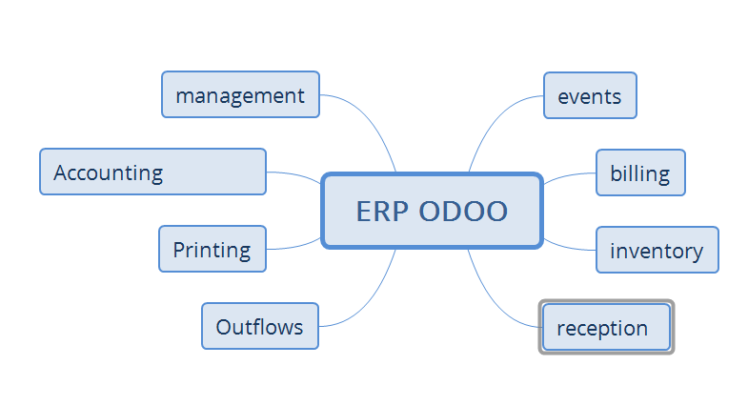
ERP odoo
Notes:
Odoo offers a wide range of integrated modules, including:
Purchase and Sales Management
Human Resources
Inventory Control
Accounting
Events Planning
Barcode Printing
Reception
Billing

Slide 3

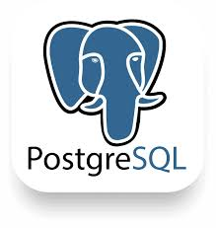




What type of database
Enhanced Security
Advanced security features including role-based access control
Validated Performance
Proven reliability in enterprise environments
Mastered Technology
Extensively used internally in Debian systems
Notes:
The database engine used is PostgreSQL, deployed within a Debian environment. This choice is driven by our team's expertise, PostgreSQL’s increases security, and its internal validation within our infrastructure. It is also perfectly aligned with Debian-based deployments.

Slide 4




Characteristics of the data
Structured data
Server Cluster
Volume 100 gb
Data are inserted manually (orders, events, items) without needing rapid or frequent insertions.
Notes:
Our database setup has the following main features:
Structured Data Model: The database uses a structured data model to keep data organized and efficient.
Clustered Server Architecture: It runs on a clustered server setup, which improves reliability and performance.
Data Volume: The system can manage up to 100 GB of data.
Manual Data Entry: Manual data entry is mostly used for daily orders, events, and articles.
Even with this data volume, speed is not a major issue because the system doesn't need frequent or quick data additions. This allows for a simpler and more controlled data process.

Slide 5


What type of database
Type of request :
Consistency Requirements:
Single line reads
Low volume per request
🔄 Simple CRUD operations
❌ No mass processing
Total consistency required:
🚫 No tolerance for mismatch
🛡️ Strict referential integrity
✅ Real-time constraint validation
Notes:
Performance and Query Pattern
Optimized for Single-Line Reads: The database is designed to quickly read single lines of data.
Low Volume per Request: It handles small amounts of data per request, making it great for simple tasks.
Ideal for Simple CRUD Operations: The system is very efficient for basic tasks as Create, Read, Update, and Delete (CRUD).
Not Designed for Bulk Data Processing: It is not meant for handling large amounts of data or many requests at once.
Consistency Requirements
Full Data Consistency: The system must always have consistent data, with no errors, even small ones.
Strict Referential Integrity: It ensures data is always accurate and checks rules in real-time.

Slide 6







Transaction support
Transactions ACID
Yes necessary
Associated risks
without proper transaction support
Potential issues
Critical business impacts
Loss of data integrity.
Production errors.
Loss of accounting traceability for accounts and their transparency
Notes:
Our system follows ACID rules, which means:
Atomicity: All parts of a task are completed, or none are, keeping data safe.
Consistency: The database stays correct after every task.
Isolation: Tasks don't affect each other, keeping data separate.
Durability: Data is safe even if the system fails.
Without following ACID rules, we risk:
Loss of Data Integrity: Data might become inconsistent
Production failure: Work might stop suddenly.
Loss of Accounting Transparency and Traceability: It might be hard to track money transactions.

Slide 7



Fault tolerance
Tolerance level
Low (24 hours maximum).
Recovery options
Return to paper possible
Backup strategy
Daily back-ups
No critical losses when proper backup procedures are applied.
Notes:
Low Fault Tolerance: The system can be down for up to 24 hours if there's a problem.
Failure Protocol: If there's a failure, the system switches to paper-based work temporarily. Daily backups make sure no important data is lost.

Slide 8








Reading Pattern vs. Writing Pattern
Stable Data Model
Read Operations
Well-defined schema with no frequent structural changes
Primarily single-record lookups with moderate complexity
Query Optimization
Write Operations
Standard indexing are adequate for performance needs
Manual data entered with predictable transaction patterns
The data model is well-defined and stable, meaning it does not change frequently. This allows an easier management and better performance of requests.
Notes:
Stable Data Model: The system has a stable and clear data model.
Easier Maintenance: This makes it easier to maintain and improves how queries are handled.
Read-Intensive Operations: The system is easily used for reading data, so writing data is less important.

Slide 9
Type of work
Main use
Interactive queries.
Critical performance metrics:
Availability with a low rate of incidents during office hours.
Notes:
Interactive Queries: The database is mainly used for interactive questions.
High Availability During Business Hours: It's important for the system to be available during work hours.
Designed for Low Incident Rates: The system is made to have few issues and run perfectly every day.

Slide 10



Various factors
Team skills
Risk tolerance
Dependencies
Experience with Oracle-derived databases
Balanced approach to risk management
Timetable
Mobile application
Already implemented in 2023
LDAP integration knowledge
24-hour availability
Notes:
Experience with Oracle-Derived Databases: The team is experienced with databases similar to Oracle.
24/7 Availability: The system can be used at any time.
Integrations: It works with LDAP login, mobile apps, server checks, and automatic backups.
This system was successfully set up in 2023 and continues to work well.

Slide 11
Thank you for your attention

